Slide 1
Purpose of the Project
-The interaction between weather conditions and the quality of the football matches in Premier League

Slide 2
Football is the most popular ball game in number of participants and spectators all around the world
UK is one of the world’s premier tourist destination and all come for watching premier league
Significant spectator support,TV and advertisement revenue generates huge budgets of premier league clubs
High budget clubs- high class player profile
Great competition among premier league clubs and among their fans

Slide 3
The affect of weather conditions on sports played with ball outdoor can not be underestimated
Football is one of the outdoor sports and weather conditions should have an affect on the quality of the match
If it is heavy rained, the quality comes down significantly
If there is wind, the speed and also direction of the wind affects players and direction of the ball
Moderate rain should affect football positively
Cloudy or non-cloudy;approximately no effect

Slide 4
Data Sources That We Have Used
We have used three different data sources
One is for weather data set and the other two are related with Premier league
For accessing weather conditions ,we have used
https://developer.worldweatheronline.com/api
We needed historical data on weather so we used this api
We used URL for accessing data
Supplies data in json file and processed that json file
Obtained data by editing URL or attaching parameters to the URL
İt supplies users an interactive api explorer also

Slide 5
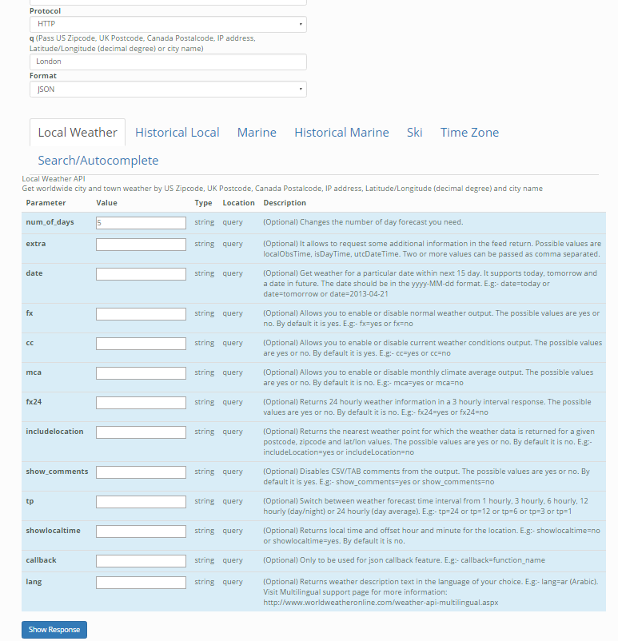
Notes:
İnteractive api explorer

Slide 6
The Data Source For Premier League
www.football-data.co
Too many historical statistics for seasons of important leagues
We have worked on premier league season 2015/2016
Detailed statistics for each match
Home team shots,away team shots,shots on target for each team also, number of corners,away team name etc.
Gives data into a csv file
Each match record includes all of these statistics excluding the time of the match
We need time so we used another api to match each match record

Slide 7
Other Data Source for Season 2015/2016
http://api.football-data.org/
Contains match records including the exact time of the match and date
Data is in json file
Does not contain detailed statistics of each match record
It contains score of the match also
Api format uses token instead of URL

